Slide 1
Classification of Environmental and Urban Sounds through Deep Learning Techniques
Mentor : Dr. B. Surekha Reddy (Assistant Professor)
Team :
D Mohith Chowdary | 21951A04A4
R Srinivas | 21951A04L6
MD Ossama Rahmani | 22955A0412

Slide 2
ABSTRACT
Environmental sound classification (ESC) is a critical aspect of developing intelligent auditory systems for applications such as smart cities, surveillance, and multimedia analysis.
This project proposes a hybrid model that leverages both Transformer and LSTM (Long Short-Term Memory) networks to improve the accuracy of sound classification tasks.
By combining the self-attention mechanism of Transformers with the sequential memory capabilities of LSTM, the model aims to effectively capture both short-term and long-term dependencies in environmental sounds.
Results demonstrate superior performance compared to traditional models, offering an improvement over baseline methods.

Slide 3
Real-World Applications
Urban Sound Monitoring: Detect and classify multiple noise sources (e.g., vehicles, construction) in smart cities, helping to manage urban noise pollution and improve quality of life.
Smart Cities: Applications such as traffic management can benefit from accurate sound classification by distinguishing between different vehicle types or events like sirens and horns.
Environmental Sound Detection: Detect sounds in natural settings for wildlife conservation, where animal sounds may be used to monitor their population and activities.
Security Systems: Classify sounds in public spaces to identify suspicious activities or events, improving surveillance accuracy in airports, train stations, or large gatherings.

Slide 4
Literature Survey:
Zhang et al. (2020): Proposed a convolutional RNN combining CNNs and bidirectional GRUs to capture spatial and temporal sound patterns using log-mel spectrograms, improving classification accuracy.
L. Zhou et al. (2021): Developed the Feature Pyramid Attention Network (FPAM), which leverages multi-scale hierarchical feature extraction with spatial and channel attention mechanisms for improved sound classification.
Bansal et al. (2021): Proposed a hybrid ensemble classifier combining five machine learning models, and a CRNN model achieving 93.58% accuracy on the UrbanSound8k dataset.
Guzhov et al. (2022): Utilized ResNet and Siamese networks to handle mono and stereo sound inputs with log-power STFT spectrograms.

Slide 5
Liu et al. (2022): Introduced the Causal Audio Transformer (CAT), which incorporates multi-feature extraction and acoustic attention for enhanced audio modeling.
Xiao et al. (2023): Developed SemanticAC, a semantics-assisted framework that aligns audio signals with semantic-rich class labels, improving classification accuracy.
Nasef et al. (2023): Proposed a Residual Self-Attention (RSA) model, achieving over 93% accuracy on benchmark datasets using MFCC inputs and attention-based architectures.
IniK et al. (2023): Applied Particle Swarm Optimization (PSO) to tune CNN architectures, achieving state-of-the-art performance on ESC-50, ESC-10, and UrbanSound8k.

Slide 6
Problem Statement:
Traditional deep learning models like CNNs and RNNs face challenges in capturing the overall context and long-range connections needed to differentiate between sound sources. This limitation is especially problematic in real-world scenarios, including urban sound analysis, public safety, healthcare, and environmental monitoring, where accurate sound identification is crucial.

Slide 7
Proposed Method
Transfer Learning using Audio Spectrogram Transformer (AST): AST is based on Vision Transformer (ViT), AST converts raw audio signals into spectrogram images and applies a vision transformer model. The spectrogram is split into image patches, each converted into vector embeddings, which are stacked and fed into the transformer. AST is an encoder-only transformer, facilitating easy implementation and transfer learning from ViT.
Proposed Model: We extend AST by incorporating Bidirectional-LSTM for memory retention, adding sequential blocks to the AST output. This block consists of a Bi-LSTM layer, 3 linear layers, batch normalization, and dropout, as shown in Fig. 2.

Slide 8
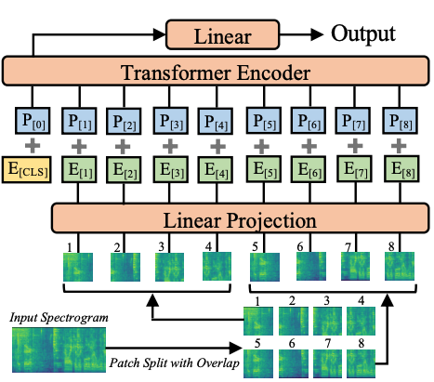
Fig. 1. Architecture of Audio Spectrogram Transformer by (Gong. Et al)

Slide 9
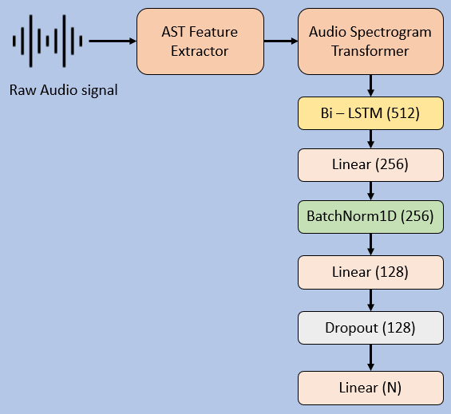
Fig. 2. Our proposed model Diagram

Slide 10
Implementation:
In our implementation, we used three key datasets for training the model: ESC-10, ESC-50, and UrbanSound8K. These datasets are widely recognized benchmarks for Environmental Sound Classification (ESC) and provide a diverse range of audio samples for evaluating machine learning model performance.
The ESC-10 dataset contains 400 audio files categorized into 10 distinct classes, while ESC-50 is a larger dataset with 2000 audio files spanning 50 different categories. Both datasets are divided into five folds for cross-validation, allowing for a robust evaluation of model performance across different subsets of the data.
UrbanSound8K contains 8732 audio files categorized into 10 different classes and is frequently used for training models that need to classify various urban sound events, such as car horns, sirens, and street music.

Slide 11
The ESC-10 and ESC-50 datasets have an equal distribution of audio samples but are small. UrbanSound8K is larger but suffers from class imbalance. To address this, we used data augmentation techniques including time stretching, pitch shifting, and addition of white noise to diversify the audio samples and improve the model's robustness during training.
The augmentation techniques applied included:
1. Time Stretching by two factors: 0.8 and 1.2.
2. Pitch Shifting by factors of -2 and 2.
3. Addition of white noise, with a random factor in the range of [0.005, 0.008].

Slide 12
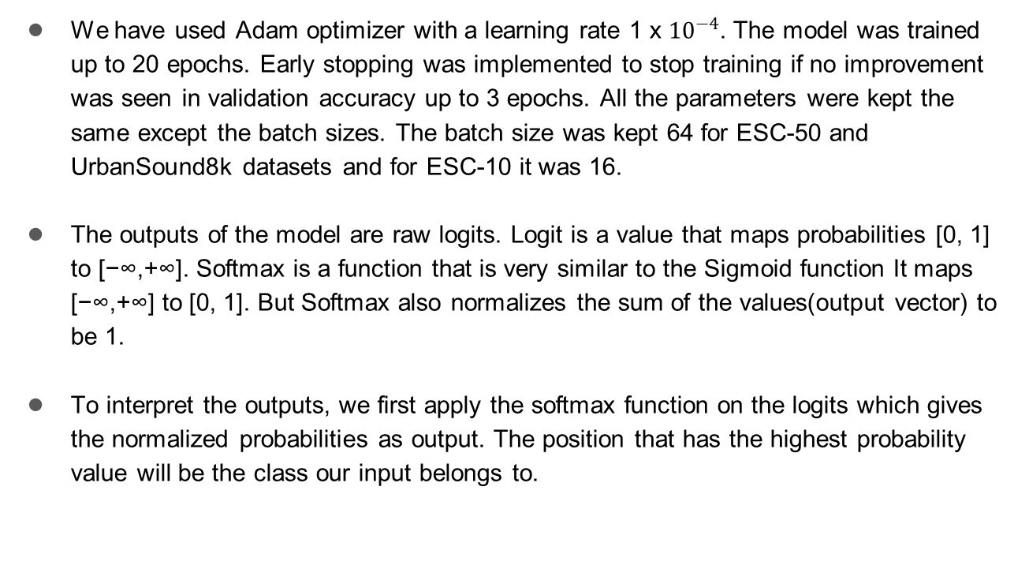
We have used Adam optimizer with a learning rate 1 x ${10}^{−4}$. The model was trained up to 20 epochs. Early stopping was implemented to stop training if no improvement was seen in validation accuracy up to 3 epochs. All the parameters were kept the same except the batch sizes. The batch size was kept 64 for ESC-50 and UrbanSound8k datasets and for ESC-10 it was 16.
The outputs of the model are raw logits. Logit is a value that maps probabilities [0, 1] to [−∞,+∞]. Softmax is a function that is very similar to the Sigmoid function It maps [−∞,+∞] to [0, 1]. But Softmax also normalizes the sum of the values(output vector) to be 1.
To interpret the outputs, we first apply the softmax function on the logits which gives the normalized probabilities as output. The position that has the highest probability value will be the class our input belongs to.

Slide 13
Results :
Our model has achieved a better result than anticipated on all three benchmark datasets. This demonstrates that by combining attention mechanisms like transformers with networks like LSTM we can achieve state-of-the-art results. The model has shown remarkable performance in all 3 datasets.
The authors of ESC-50 and UrbanSound8k have recommended performing 5-fold and 10-fold cross-validation respectively to avoid incorrect results. To be specific use one of the folds of the dataset to test the model and the rest of the folds to train the model. Repeating this process for every fold and reporting the average of the results was the recommended procedure. So we have done the same and reported the average of all the folds.
Dataset | Accuracy
ESC-10 | 99.99 %
ESC-50 | 99.99 %
UrbanSound8k | 99.96 %

Slide 14
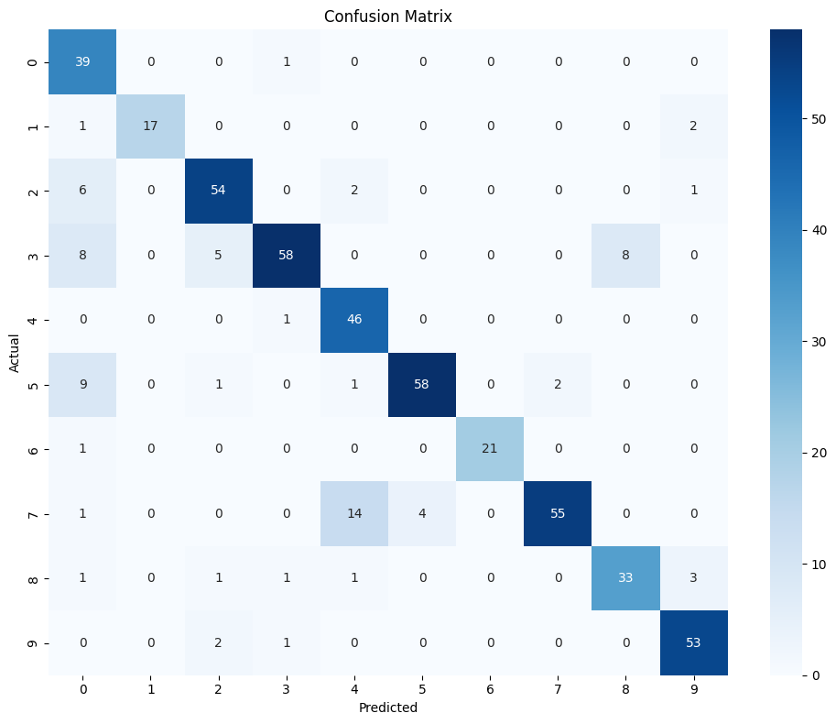
Confusion Matrix of the model on ESC-10 (10-classes)

Slide 15
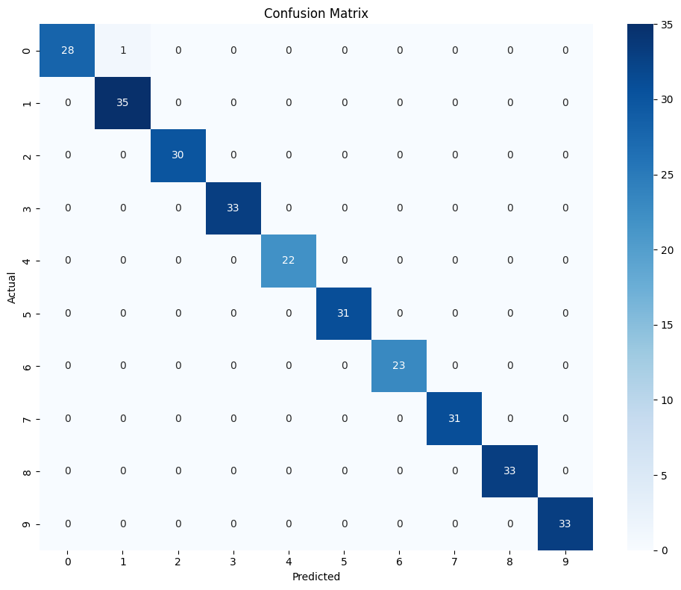
Confusion Matrix of the model on UrbanSound8k (4th fold)

Slide 16
Comparison of Results with existing models in terms of Accuracy %
Model | ESC-10 | ESC-50 | US8K
Attention + CRNN [4] | 93.7 | 86.1 | -
FPAM [5] | 99.3 | 91.6 | -
Hybrid Ensemble Model [6] | 70 | - | 79.4
CRNN + MFCC [7] | - | - | 93.58
AST [12] | 98.11 | - | -
CAT [9] | - | 86.7 | 96.1
SemanticAC [10] | - | 97.25 | 91.34
ESResNet [8] | 97.0 | 91.5 | 84.2
RSA [11] | 97.8 | 96.25 | 93.31
CNN + PSO [17] | 98.64 | 93.71 | 98.45
Our Approach | 99.99 | 99.99 | 99.6

Slide 17
CONCLUSION
In this project, we present an approach that uses the Audio Spectrogram Transformer pre-trained on Audioset combined with a sequential block containing LSTM, Linear, and Dropout layers. The proposed model was tested on ESC-10, ESC-50, and UrbanSound8k datasets. We achieved success rates of 99.99% on ESC-10, 99.99% on ESC-50, and 99.6% on UrbanSound8k. This was done using a complete attention-based approach without convolutional layers. This proves that we can achieve state-of-the-art results on ESC using attention-based architectures like transformers just like how they were used for Image Classification.
In the future, we intend to study the ways to make our proposed model computationally less complex. This will make the deployment of the model on Edge devices easier.

Slide 18
References
K. Zaman, M. Sah, C. Direkoglu and M. Unoki, ”A Survey of Audio Classification Using Deep Learning,” in IEEE Access, vol. 11, pp. 106620-106649, 2023, doi: 10.1109/ACCESS.2023.3318015.
K. J. Piczak, ”Environmental sound classification with convolutional neural networks,” 2015 IEEE 25th International Workshop on Machine Learning for Signal Processing (MLSP), Boston, MA, USA, 2015, pp. 1-6, doi: 10.1109/MLSP.2015.7324337
A. Vaswani, N. Shazeer, N. Parmar, J. Uszkoreit, L. Jones, A. N. Gomez, L. Kaiser, and I. Polosukhin, “Attention is all you need,” in NIPS, 2017.
Zhichao Zhang, Shugong Xu, Shunqing Zhang, Tianhao Qiao, Shan Cao, Attention based convolutional recurrent neural network for environmental sound classification, Neurocomputing, Volume 453, 2021, Pages 896-903, ISSN 0925-2312, https://doi.org/10.1016/j.neucom.2020.08.069.
Liguang Zhou, Yuhongze Zhou, et al, ”Feature Pyramid Attention based Residual Neural Network for Environmental Sound Classification,” 2022, https://doi.org/10.48550/arXiv.2205.14411
Anam Bansal, Naresh Kumar Garg, Environmental Sound Classification using Hybrid Ensemble Model, Procedia Computer Science, Volume 218, 2023, Pages 418-428, ISSN 1877-0509, https://doi.org/10.1016/j.procs.2023.01.024.

Slide 19
Bansal, A., Garg, N.K. Robust technique for environmental sound classification using convolutional recurrent neural network. Multimed Tools Appl 83, 54755–54772 (2024). https://doi.org/10.1007/s11042- 023-17066-2
A. Guzhov, F. Raue, J. Hees and A. Dengel, ”ESResNet: Environmental Sound Classification Based on Visual Domain Models,” 2020 25th International Conference on Pattern Recognition (ICPR), Milan, Italy, 2021, pp. 4933-4940, doi:10.1109/ICPR48806.2021.9413035.
X. Liu, H. Lu, J. Yuan, and X. Li, ”CAT: Causal Audio Transformer for Audio Classification,” ICASSP 2023 – 2023 IEEE International Conference on Acoustics, Speech and Signal Processing (ICASSP), Rhodes Island, Greece, 2023, pp. 1-5, doi:10.1109/ICASSP49357.2023.10096787.
Y. Xiao, Y. Ma, S. Li, H. Zhou, R. Liao and X. Li, ”SemanticAC: Semantics-Assisted Framework for Audio Classification,” ICASSP 2023 - 2023 IEEE International Conference on Acoustics, Speech and Signal Processing (ICASSP), Rhodes Island, Greece,
Nasef, M.M., Nabil, M.M. & Sauber, A.M. Multiclass environmental sound classification model based on adding residual connections to self-attention layers. Multimed Tools Appl 83, 71359–71377 (2024). https://doi.org/10.1007/s11042-024-18421-7

Slide 20
Yuan Gong, Yu-An Chung, and James Glass, “Ast: Audio spectrogram transformer,” arXiv preprint arXiv:2104.01778, 2021.
A. Dosovitskiy, L. Beyer, A. Kolesnikov, D. Weissenborn, X. Zhai, T. Unterthiner, M. Dehghani, M. Minderer, G. Heigold, S. Gelly, J. Uszkoreit, and N. Houlsby, “An image is worth 16x16 words: Transformers for image recognition at scale,” in ICLR, 2021.
https://huggingface.co/MIT/ast-finetuned-audioset-10-10-0.4593
Karol J. Piczak. 2015. ESC: Dataset for Environmental Sound Classification. In Proceedings of the 23rd ACM international conference on Multimedia (MM ’15). Association for Computing Machinery, New York, NY, USA, 1015–1018. https://doi.org/10.1145/2733373.2806390
Justin Salamon, Christopher Jacoby, and Juan Pablo Bello. 2014. A Dataset and Taxonomy for Urban Sound Research. In Proceedings of the 22nd ACM international conference on Multimedia (MM ’14). Association for Computing Machinery, New York, NY, USA, 1041–1044. https://doi.org/10.1145/2647868.2655045
O¨ zkan I˙nik, CNN hyper-parameter optimization for environmental sound classification, Applied Acoustics, Volume 202, 2023, 109168, ISSN 0003-682X, https://doi.org/10.1016/j.apacoust.2022.109168.

Slide 21
Thank You

